Slide 1

CDIO – Autumn 2015

Slide 2
Content
Project members
Project goals
System
Flow chart
OpenStreetMap
Features
Neural Network
Post processing
Result
Discussion
Questions

Slide 3







Project members

Slide 4
Project goal
Background
Vricon
Specifications

Slide 5
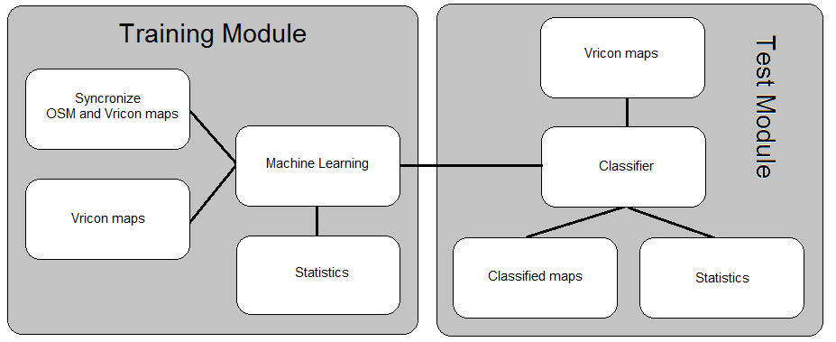
System – flow chart

Slide 6
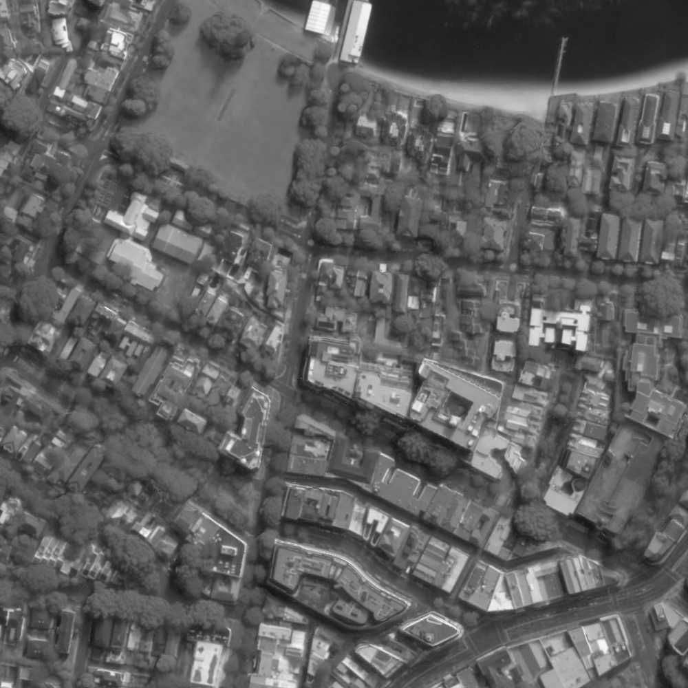
System - OpenStreetMap
Ground truth

Slide 7
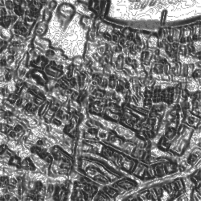
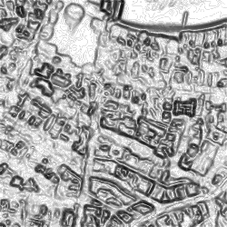
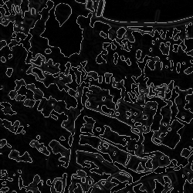
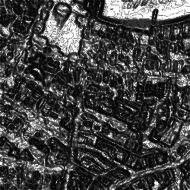
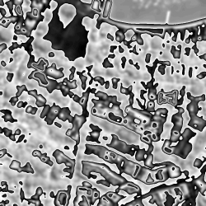
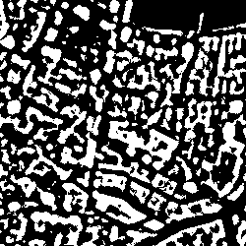
System - Features
Gray level co-occurrence matrix
Energy
Homogeneity
Dissimilarity
ASM
Mean value
Height map

Slide 8
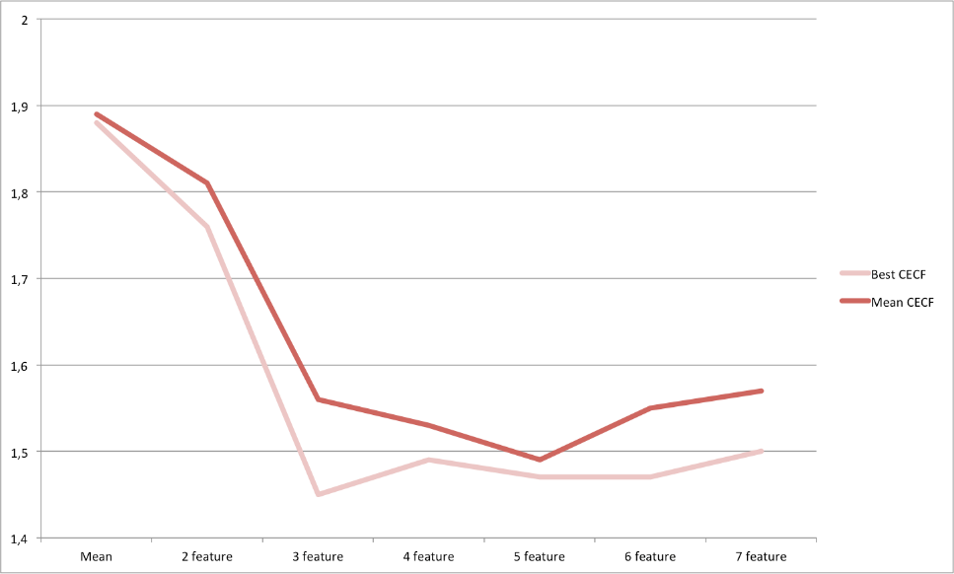
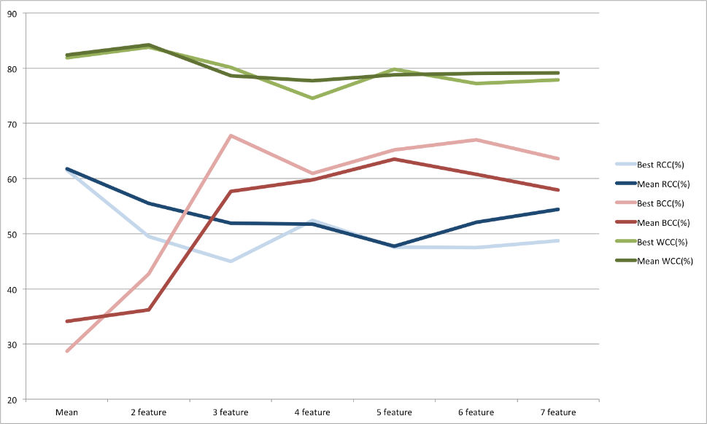
System – features
Approach

Slide 9
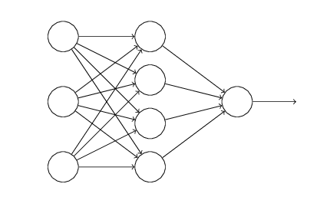
System – Neural Network
Neural Network
Approach

Slide 10
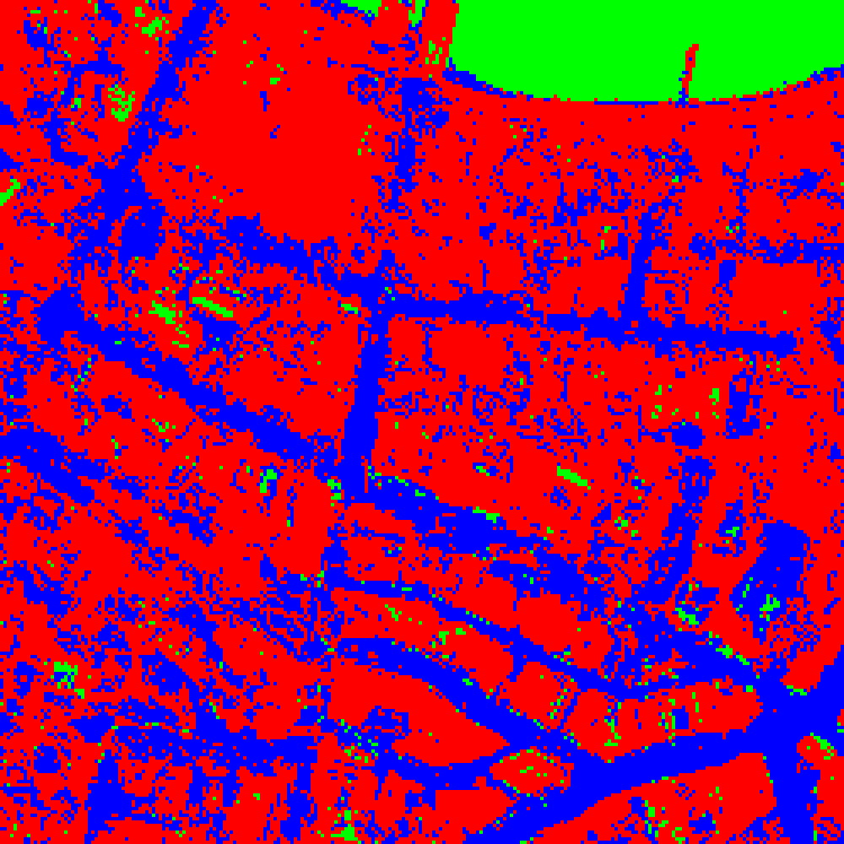
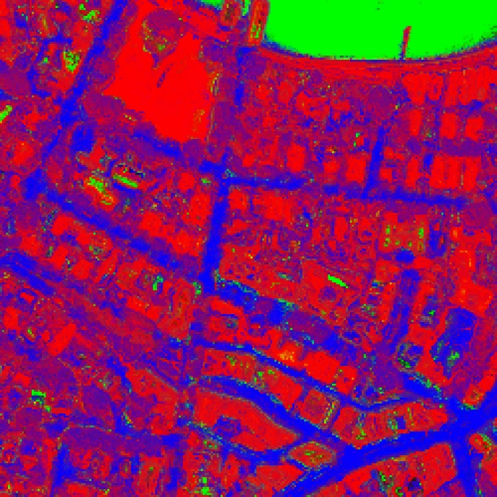
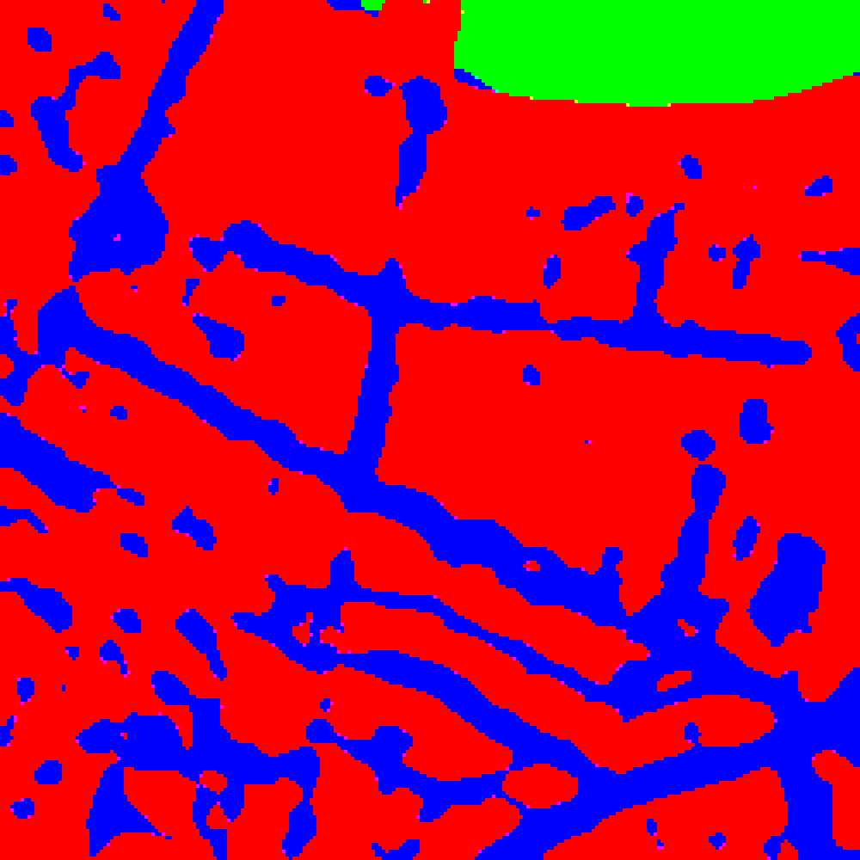
Post processing
ProcessG

Slide 11

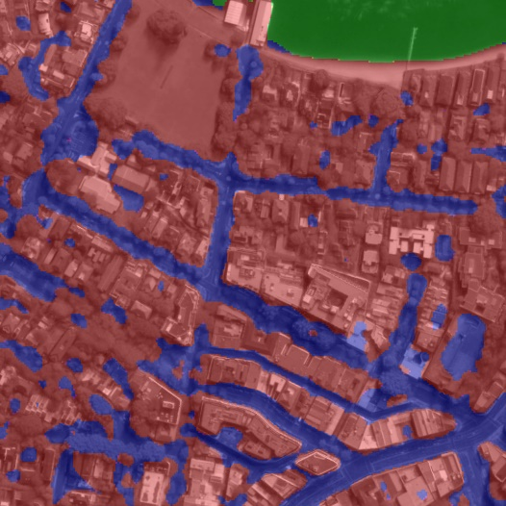
Result

Slide 12
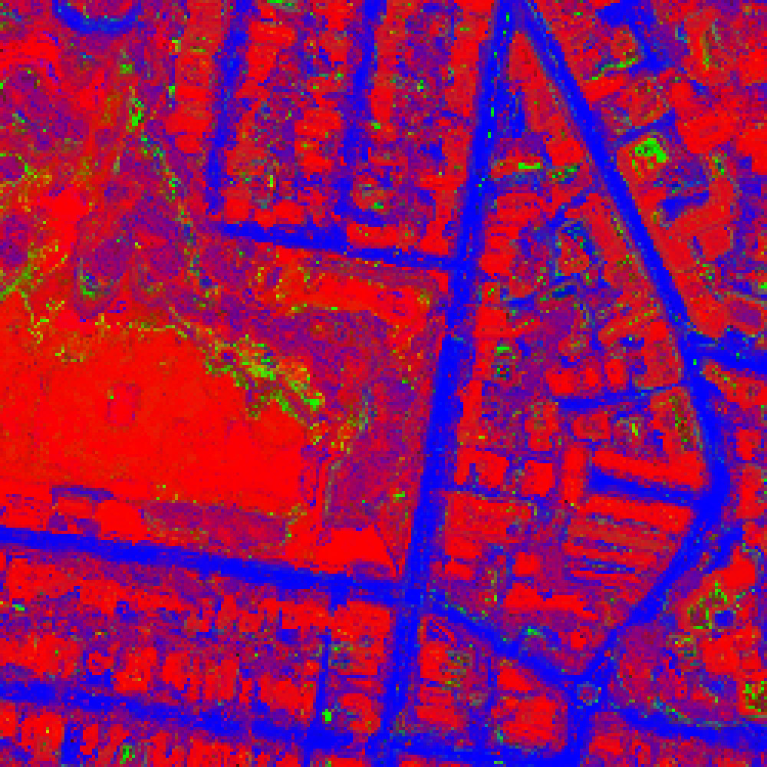
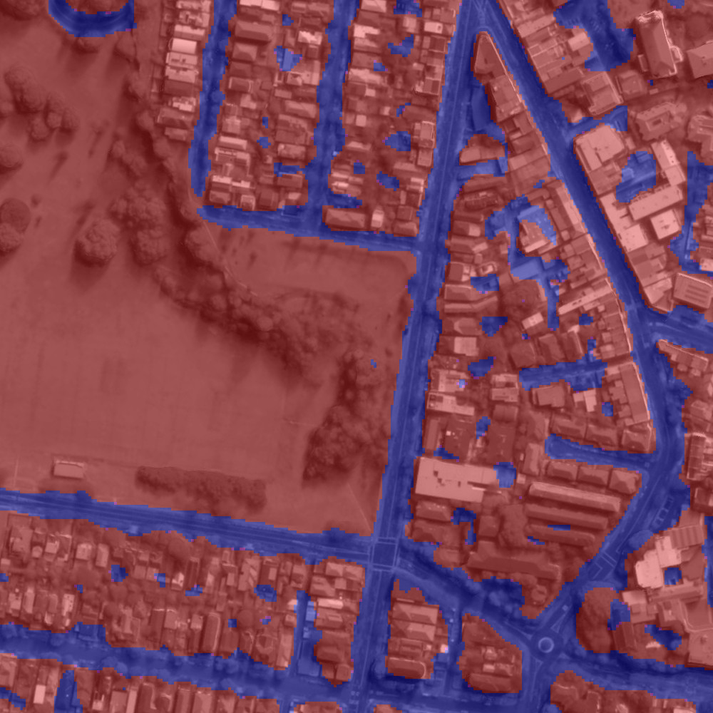
Result

Slide 13
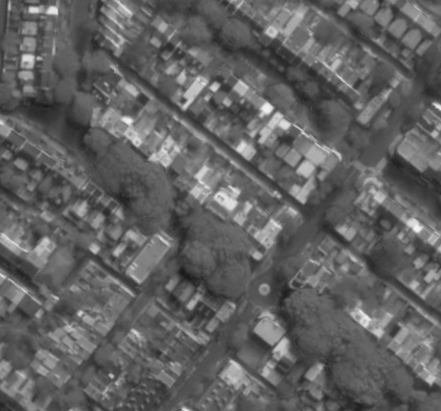
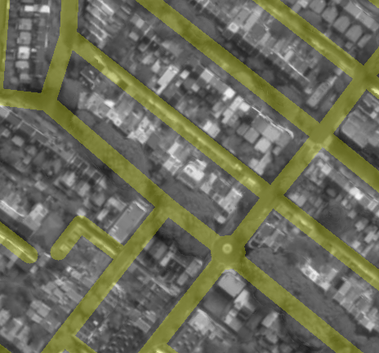
Discussion
OSM imperfect ground truth
Trees
Road width

Slide 14
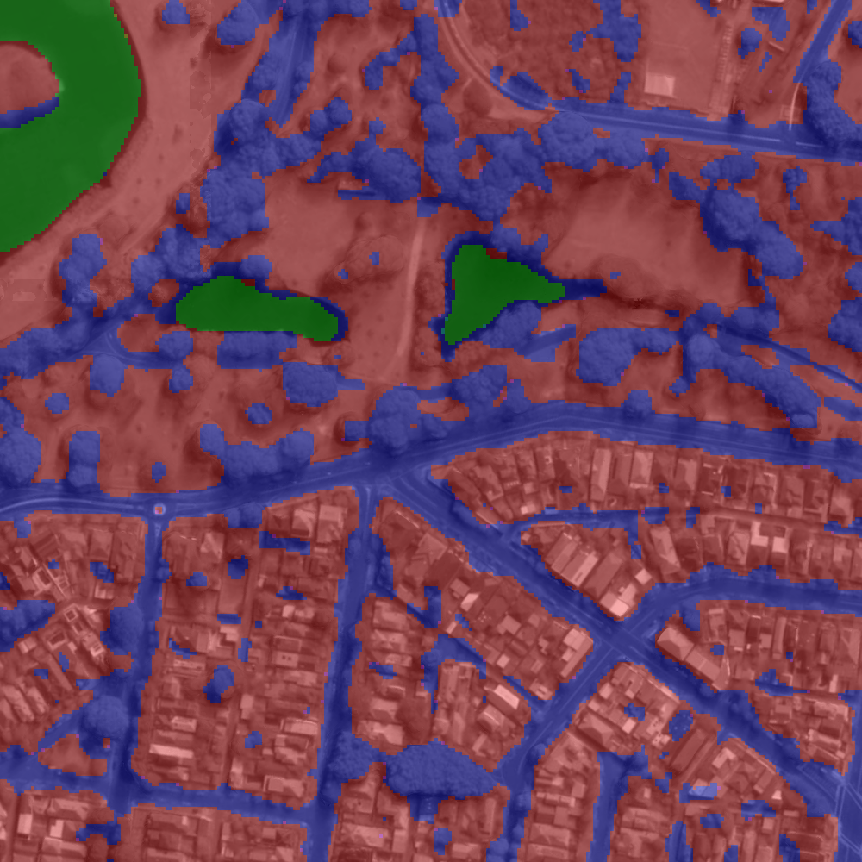
Discussion
Trees as road

Slide 15
Questions?

